Slide 1
Carpenters Practice
Virtual Patient Participation Meeting
Wednesday, 29 March 2023

Slide 2
Agenda
Introduction
The Practice Team/Changes
Social Prescriber, Care Coordinator, PCN News
Friends and Family Test
GP Patient Survey 2023
Online consultations – DR IQ
Women’s Health Programme April 2023
Role of the chair/ vice-chair/ Role of secretary
Questions and feedback from PPG members

Slide 3
Multi-Professional Team
Dr Elizabeth Heptinstall - Clinical Lead and Regional Medical Director
Dr Tim Lee – Safeguarding Lead
Dr Muhammed Patel- Mental Health Lead
Dr Faiza Bhikoo – General Practitioner
Dr Viraj Bandara – General Practitioner
Dr Rabia Faryal – General Practitioner
Dr Rumana Aktar – General Practitioner
Dr Naeem Mitha – General Practitioner
Dr Aveleen Singh – General Practitioner
Dr Nathaneil Rogers - General Practitioner
Ushma Parmanand - Clinical Pharmacist
Rasheeda Jennifer Adeyemo - Clinical Pharmacist
Ekta Sajgotra – Physiotherapist
Ana Gomes – Regional Nurse Manager
Amanda Clare – Practice Nurse
Dorcas Gbogi – Practice Nurse
Farzana Miah – Practice Nurse
Margaret Mbachu – Practice Nurse
Einas Basit – Physician Associate
Hannah Dumbuya – Physician Associate
Ashley Gwillim – Health Care Assistant
Hena Ahmed - Health Care Assistant
Nushrath Nazar – Social Prescriber
Umran Ali – Care-coordinator
Our multi-professional team gives you choice, enhanced access and an improved experience.

Slide 4
PCN News
Newham Central PCN
PCN PPG
Enhanced Services
Local Services - Community pharmacist consultation service (CPCS)
ARRS – Clinical Pharmacists (2), Physiotherapist, Social prescriber, Care-coordinator

Slide 5
Care Coordinator
Purpose and duties:
• Proactively identify and work with a cohort of people to support their personalised care requirements, using the available decision support aids
• Bring together a person’s identified care and support needs and explore their options to meet these into a single personalised care and support plan, in line with person-centred service plan (PCSP) best practice
• Help people to manage their need, answering their queries and supporting them to make appointments
• Support people to take up training and employment, and to access appropriate benefits where eligible
• Raise awareness of shared decision making and decision support tools and assist people to more prepared to have a shared decision-making conversation
• Ensure that people have good quality information to help them make choices about their care
• Support people to understand their level of knowledge, skills and confidence (*Patient Activation” level) when engaging with their health and wellbeing, including through use of the patient activation measure
• Assist people to access self-management education courses, peer support or interventions that support them in their health and wellbeing
• Explore and assist people to access personal health budgets where appropriate
• Provide coordination and navigation for people and their carers across health and care services, alongside working closely with social prescribing link workers, health and wellbeing coaches and other primary care roles
• Support the coordination and delivery of MDTs within PCNs *The Patient Activation Measure (PAM) helps to measure the spectrum of knowledge, skills and confidence in patients and captures the extent to which people feel engaged and confident in taking care of their condition.

Slide 6
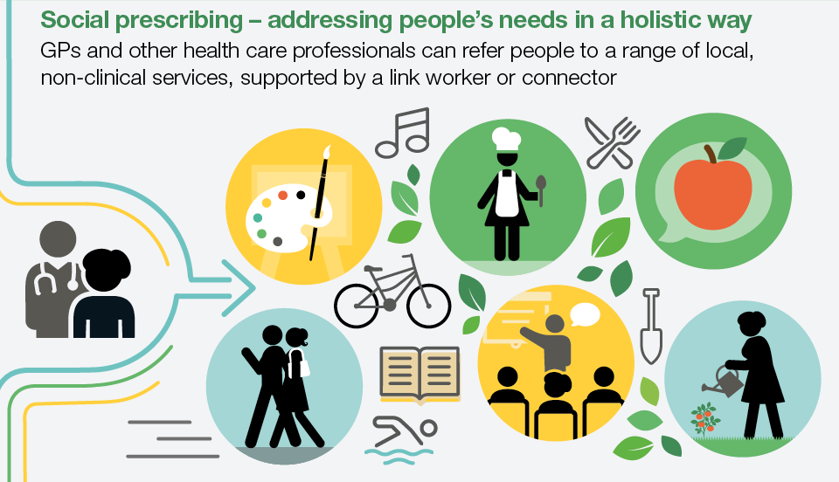
Social Prescriber
Purpose and duties:

Slide 7
Role of the chair
Ensure PPG meetings are planned in advance
Oversee the smooth running of the meeting by starting the meeting on time, welcoming people and outlining the meeting purpose and agenda purpose
Keep the meeting moving along on time according to the agenda
Introduce speakers when required
Ensure everyone has the chance to contribute
Summarise decisions at the end of each agenda item
Ask clarifying questions and challenge disruptive behaviour
Thank everyone for their time and input
Ensure the PPG functions in accordance with its Terms of Reference and Code of Conduct
Represent the PPG as appropriate
Ensure there is successful dialogue between the PPG and its GP practice
Qualities of an effective chair
Willingness to lead
Conducts themselves with tact and diplomacy
Able to listen impartially to many opinions
Works inclusively and openly

Slide 8
Role of vice-chair
Stand in for the chair when they are away
Assist the chair with matters between meetings
Role of secretary
Deals with communications and correspondence
Sends out meeting invitations and circulates agenda and any other relevant documents before the meeting
Sends minutes of meeting and decisions taken to chair for approval
Sources necessary equipment/materials
Circulates finalised minutes
Qualities of an effective secretary
Good communications skills
Attention to details
Good organisational skills

Slide 9
next PPG Meeting will be on 29 June 2023

